Slide 1
Matthew 25 Invitation
Synod of the Trinity
Beaver- Butler Presbytery

Slide 2
Matthew 25:37-40
³⁷ Then the righteous will answer him, “Lord, when was it that we saw you hungry and gave you food, or thirsty and gave you something to drink? ³⁸ And when was it that we saw you a stranger and welcomed you, or naked and gave you clothing? ³⁹ And when was it that we saw you sick or in prison and visited you?” ⁴⁰ And the king will answer them, “Truly I tell you, just as you did it to one of the least of these who are members of my family, you did it to me.”

Slide 3
Building Congregational Vitality
Dismantling Structural Racism
Eradicating Systemic Poverty

Slide 4
Building Congregational Vitality
Spiritual strength
A congregation’s capacity for purposeful mission

Slide 5
Building Congregational Vitality
Seven marks to determine a congregation’s level of vitality

Slide 6
Building Congregational Vitality
Seven marks to determine a congregation’s level of vitality
A commitment to forming disciples over every member’s lifetime
Embracing the call to evangelism

Slide 7
Building Congregational Vitality
Seven marks to determine a congregation’s level of vitality
A commitment to forming disciples over every member’s lifetime
Embracing the call to evangelism
An outward focus
Empowering members

Slide 8
Building Congregational Vitality
Seven marks to determine a congregation’s level of vitality
A commitment to forming disciples over every member’s lifetime
Embracing the call to evangelism
An outward focus
Empowering members
Spirit-inspired worship

Slide 9
Building Congregational Vitality
Seven marks to determine a congregation’s level of vitality
A commitment to forming disciples over every member’s lifetime
Embracing the call to evangelism
An outward focus
Empowering members
Spirit-inspired worship
Caring relationships modeled on God’s love

Slide 10
Building Congregational Vitality
Seven marks to determine a congregation’s level of vitality
A commitment to forming disciples over every member’s lifetime
Embracing the call to evangelism
An outward focus
Empowering members
Spirit-inspired worship
Caring relationships modeled on God’s love
Congregations with healthy systems

Slide 11
Dismantling Structural Racism
Ways structural racism
is a part of our communities and daily lives:

Slide 12
Dismantling Structural Racism
Ways structural racism
is a part of our systems:
Housing discrimination
Denying access
Food apartheid
Mass incarceration
Environmental racism

Slide 13
Eradicating Systemic Poverty
What is systemic poverty?

Slide 14
Eradicating Systemic Poverty
Systemic poverty is manifested in:
Racism, classism, ageism and sexism
Homelessness
High debt loads and retirement insecurity
Conflict, violence and militarism
Poverty, climate change and ecological injustice

Slide 15
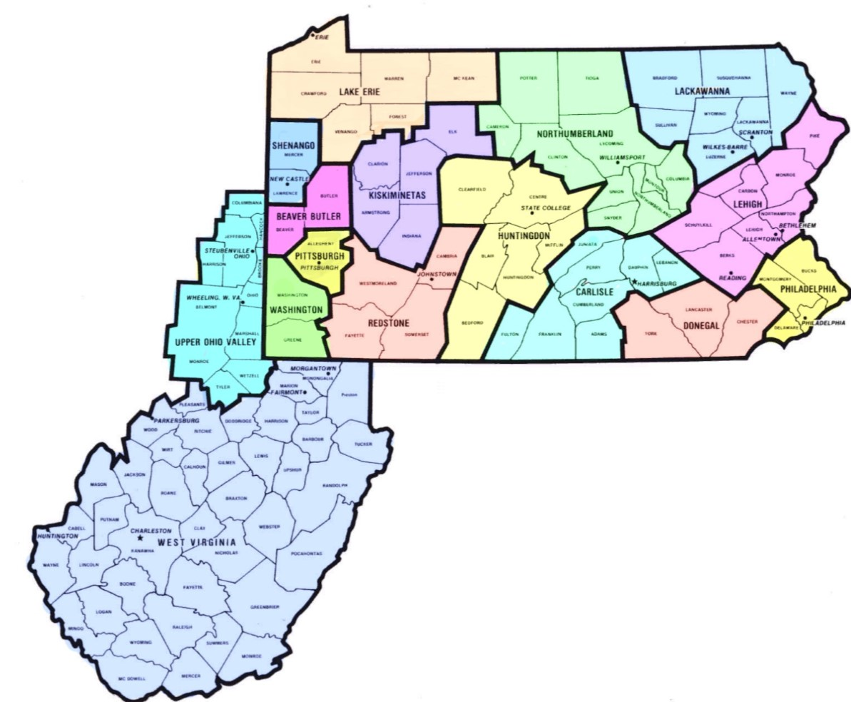
Who’s in?
Synod of the Trinity
Beaver-Butler Presbytery

Slide 16
Building Congregational Vitality
Parker PC (Beaver-Butler)
Biblical literacy program

Slide 17
Dismantling Structural Racism
Synod of the Trinity
Freedom Grants

Slide 18
Eradicating Systemic Poverty
Many congregations
Food pantries/food boxes

Slide 19
IF: Energy flows where attention goes.”
AND
‘… where your treasure is, there your heart will be also. ‘ ^{Matthew 6:21}
Then this invitation is a framework or pathway to explore what God is calling us to do in our work as congregations and as a presbytery. Let us inspire each other to think about how we can focus our attention on the goals of Matthew 25 so that energy may flow toward these priorities of faith.
Please share your congregation’s response to the M25 invitation with MCM.

