Slide 1


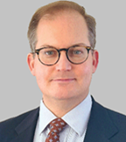
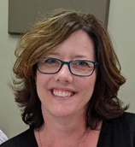
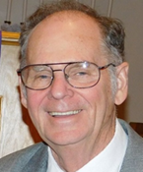
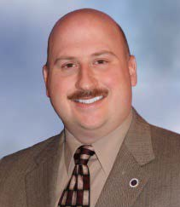
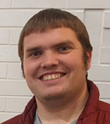
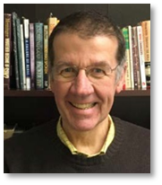



Congregations Connected Reach out to your Executive and Presbytery Officers
Rev. Dr. Tom Harmon, Executive Presbyter
executivepresbyter@beaverbutler.org 724-452-7515
Focuses Presbytery vision and oversees staff and office
Supports Presbytery churches, pastors, and ministries
Encourages development of future church leaders
Engages with community ecumenical partners
Elder Lauren Cesnales, Treasurer
laurencesnales@beaverbutler.org 724-452-7515
Provides church treasurer training
Assists churches with financial matters
Elder Dennis Krebs, Presbytery Moderator
denniskrebs64@yahoo.com
H: 724-336-5770 C: 724-614-6427
Presides over regular and called meetings of the Presbytery
Serves as member of Coordinating Team
Rev. Randall Kemp Clow, Stated Clerk
statedclerk@beaverbutler.org 724-378-3751
Addresses questions of polity
Rev. Brian Hauser, Presbytery Vice-Moderator
pastor@mars-up.org
W: 724-625-1365 C: 724-689-3412
Assists the Presbytery Moderator
Serves as member of Coordinating Team
Rev. James Steiner, Assistant Stated Clerk
assistantclerk@beaverbutler.org 724-579-4507
Records Presbytery meeting minutes
Assists Stated Clerk
Administrative Support
Presbytery staff is glad to be of service!
Contact us if you need assistance.

Slide 2
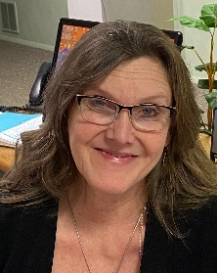

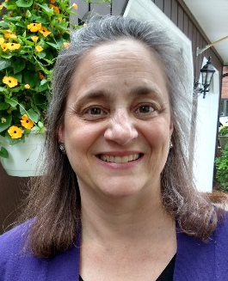
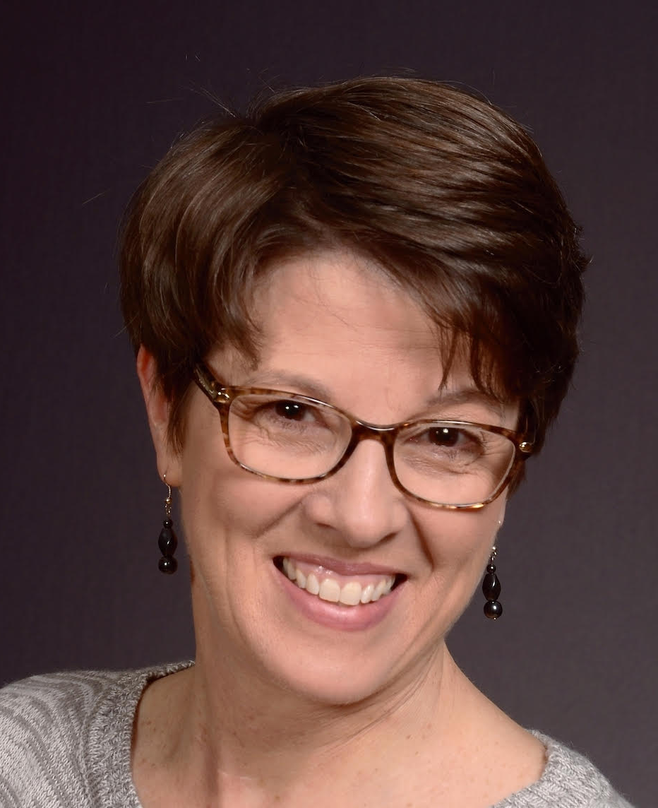
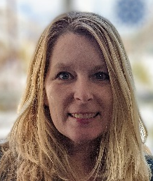

Congregations Connected Reach out to your Presbytery Office Staff
Barbara Paff, Secretary to Executive Presbyter, Officers, Committees and Units, and Office Coordinator
office@beaverbutler.org 724-452-7515
Handles general inquiries
Schedules for Rev. Dr. Harmon
Schedules Meetings at Presbytery Office
Elaine Nucci, Financial Assistant
accounting@beaverbutler.org 724-452-7515
Records Per Capita and loan payments
Processes mission donations
Assists Treasurer, Elder Lauren Cesnales
ChrisAnn Goossen, Communications Assistant
chrisanngoossen@beaverbutler.org 724-452-7515
Produces Presbytery Weekly Update e-newsletters
Maintains Presbytery website: beaverbutler.org
Oversees Resource Center
Diana Mermon Spencer, Youth Leadership Connection Director
dianamermon@beaverbutler.org 412-915-2097
Assists churches to start or maintain youth groups
Provides guidance to youth leaders
Plans and oversees Presbytery youth events
Stay Connected. Request the weekly e-newsletter! E-mail ChrisAnn! Chrisanngoossen@beaverbutler.org
Give your share.
Stronger together. Beaver-Butler congregations
For more information about Per Capita
call 724-452-7515 or visit beaverbutler.org

