Slide 1
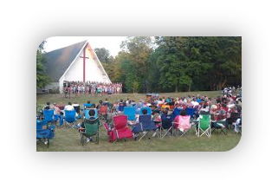
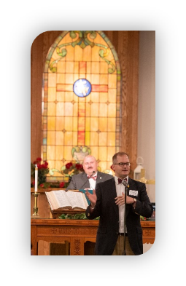


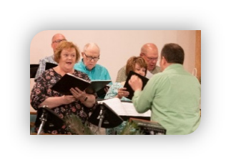
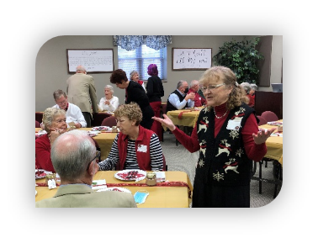
Congregations Connected
What is Per Capita?
Per Capita: an annual per member apportionment ($45.24 for 2025) that funds presbytery, synod, and general assembly efforts.

Slide 2
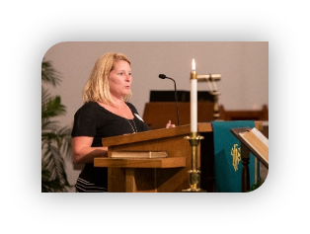



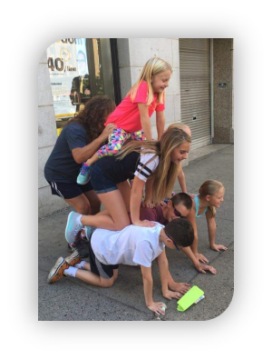
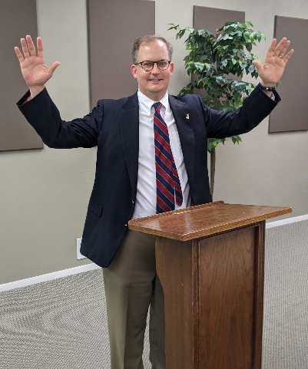

Congregations Connected
As 1 of 60 congregations in Beaver-Butler Presbytery, your church is part of a larger family that is...
enabled by shared resources
strengthened by administrative help
enlivened through combined ministry
empowered by valuable training
assisted through transition
connected to regional Synod and national PCUSA

