Slide 1
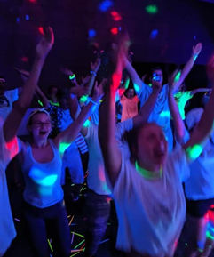
Congregations Connected
Youth Ministry Support
“Kids need someone to show them the way and help them see that their lives will be better and more fulfilled with Jesus in it.” Diana Mermon Spencer, Youth Leadership Connection Director, works with Presbytery church youth leaders.
Presbytery Youth Leadership Connection Director:
Provides training to established leaders and to churches that are considering starting a group. Youth groups can be for any age kids, preschool to high school!
Temporarily assists churches with groups without a youth leader
Fosters the growth of youth leaders by building relationships with pastors and lay people as they engage in youth ministry throughout the presbytery
Encourages and provides coordination for youth and youth leaders to participate in conferences such as Presbyterian Youth Triennium
Helps plan and organize youth group events to foster a community for youth leaders and youth to connect with other groups
Glow Party
Give your share.
Stronger together.
Beaver-Butler Congregations.
For more about
Per Capita
call: 724-452-7515
visit: Beaverbutler.org

Slide 2
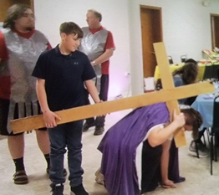
Congregations Connected
Youth Ministry Support
Presbytery Youth Leadership Connection Director (con’t):
Comes to youth group as a guest youth group leader to provide games and lessons, including special family events like “Family Feud” and trivia nights
Coordinates Presbytery-wide events: annual scavenger hunt held in various places in Allegheny, Butler and Beaver counties, prayer stations, glow parties, dances, talent shows, bands, Christian tailgate parties for local teams, and Easter Stations of the Cross – an interactive Easter experience with template available
Live Stations of the Cross
Give your share.
Stronger together.
Beaver-Butler Congregations.
For more about
Per Capita
call: 724-452-7515
visit: Beaverbutler.org
Stay Connected with Beaver Butler Presbytery Youth: calendar & announcements
For Leaders Beaver Butler Presbytery: bulletin boards, activities, games, crafts
Contact Diana Mermon Spencer at dianamermon@beaverbutler.org or 412-915-2097

